Slide 1




Snapchat
RECOMMENDATION SYSTEMS: THE POWER OF PERSONALIZATION
Present by Gautam Kumar B
gautamkumar_budida@srmap.edu.in

Slide 2



TODAY'S AGENDA
1
What is a Recommendation System?
7
Content Recommendation
2
Types of Recommendation Systems
8
Impact of Snapchat’s Recommendation System
3
Content-Based Filtering
9
The Role of Hybrid Filtering in Enhancing Snapchat's Recommendation System
4
Collaborative Filtering
10
Issues with Not Implementing Hybrid Filtering in Snapchat's Recommender System
5
Hybrid Recommendation Systems
11
Evolved significantly since its inception
6
Case Study: Snapchat’s Recommendation System
12
steps to implement hybrid recommendation system in snapchat
13
result analysis

Slide 3


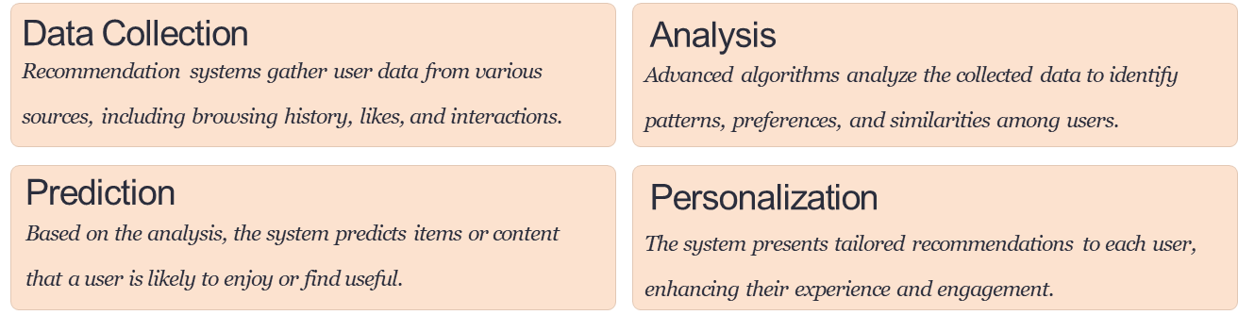
WHAT IS A RECOMMENDATION SYSTEM?
A recommendation system is an intelligent information filtering tool that uses data analysis and machine learning algorithms to suggest relevant items or content to users. These systems aim to predict user preferences and provide personalized recommendations, improving user experience and increasing engagement across various digital platforms.
John Wiley & Sons, 9 Jun 2020

Slide 4

Content-Based Filtering
This approach recommends items similar to those a user has liked in the past, based on item features and user preferences.
Collaborative Filtering
This method relies on user behavior patterns and similarities between users to make recommendations.
Hybrid Systems
TYPES OF RECOMMENDATION SYSTEMS
These systems combine multiple approaches to leverage the strengths of different recommendation techniques.
Each type of recommendation system has its unique advantages and use cases. Content-based filtering excels in scenarios with rich item metadata, while collaborative filtering shines in environments with extensive user interaction data. Hybrid systems aim to overcome the limitations of individual approaches by combining multiple techniques.

Slide 5
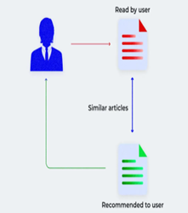
CONTENT-BASED FILTERING
Item Analysis
Similarity Matching
User Profile Creation
Recommendation Generation
Content-based filtering focuses on the characteristics of items and the preferences of individual users. This approach is particularly effective when dealing with new items or users with unique tastes. However, it may struggle with serendipitous discoveries and can be limited by the quality and depth of item metadata.

Slide 6

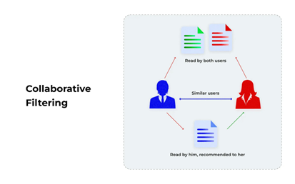



COLLABORATIVE FILTERING
User Behavior Analysis
The system collects and analyzes user interactions and ratings.
Similarity Computation
Users or items are grouped based on similarities in behavior or ratings.
Prediction
Collaborative filtering leverages the wisdom of the crowd to make recommendations. This approach can be further divided into user-based and item-based methods. User-based collaborative filtering finds similar users and recommends items they've liked, while item-based collaborative filtering identifies similar items based on user ratings.
The system predicts a user's preference for an item based on similar users or items.
Recommendation
Items with high predicted ratings are recommended to the user.

Slide 7





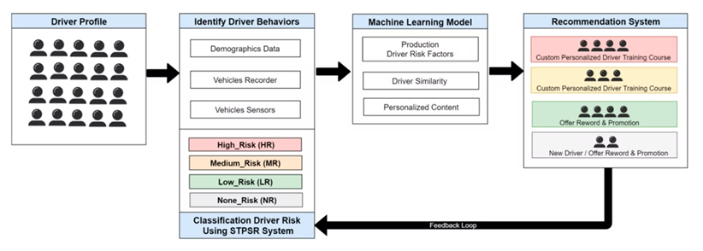
HYBRID RECOMMENDATION SYSTEMS
Integration
Balance
Adaptability
Accuracy
Combines multiple recommendation techniques to overcome individual limitations.
Balances the strengths of different approaches for optimal recommendations.
Adjusts recommendations based on available data and user behavior.
Improves recommendation accuracy by leveraging multiple data sources and methods.
Hybrid recommendation systems aim to combine the best aspects of various recommendation techniques. These systems can adapt to different scenarios, leveraging content-based filtering when dealing with new items and collaborative filtering when extensive user data is available. By integrating multiple approaches, hybrid systems can provide more robust and accurate recommendations across diverse use cases.

Slide 8
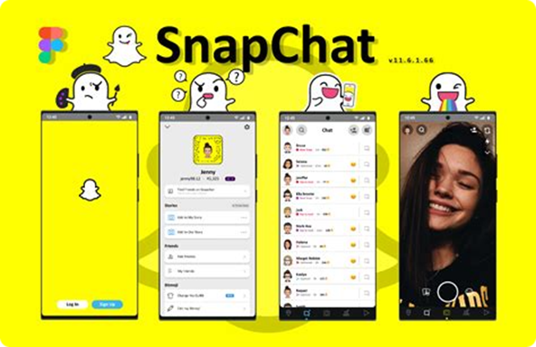
Case Study: Snapchat’s Recommendation System
OVERVIEW :-
Snapchat, a popular multimedia messaging app, has consistently focused on enhancing user engagement and personalization through advanced recommendation systems. As one of the largest social platforms with over 350 million daily active users, Snapchat’s goal is to provide relevant and engaging content tailored to each user’s preferences, habits, and interactions.
The Snapchat recommendation system is primarily applied in three key areas:
Friends and Connections Recommendations: Suggests users that a person might know or want to connect with. Objective: To increase user engagement by helping people connect with friends, acquaintances, or users with similar interests.
Content Recommendations in Discover: Personalizes media content, stories, and shows to match a user’s interests. Objective: To deliver personalized stories, news, and shows that keep users engaged on the Discover tab.
Lens and Filter Recommendations: Recommends lenses and filters based on the user’s past usage, current trends, and real-time context. Objective: To enhance the fun and interactivity of the app by recommending lenses and filters suited to a user’s past choices and real-time context (e.g., location, time, holiday).

Slide 9
CONTENT RECOMMENDATION
Data Sources
Algorithms
Output
1 | User interactions | Collaborative filtering | Personalized Discover feed
2 | Content metadata | Content-based filtering | Tailored Spotlight content
3 | Social graph | Graph-based recommendations | Friend suggestions
Snapchat's content recommendation system is a sophisticated blend of various algorithms and data sources. It analyzes user interactions, content metadata, and social connections to deliver a highly personalized experience. The system continuously learns from user behavior, adapting recommendations in real-time to keep content fresh and engaging.

Slide 10
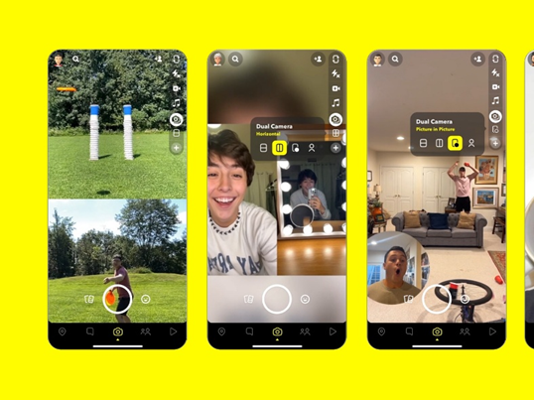
IMPACT OF SNAPCHAT’S RECOMMENDATION SYSTEM
The recommendation system has been instrumental in:
Boosting User Engagement: By delivering relevant content, Snapchat keeps users returning to the app more frequently.
Increasing Session Duration: Personalized stories, lenses, and friends’ suggestions encourage users to spend more time on the app.
Driving Advertising Revenue: The recommendation system enables targeted advertisements and sponsored content, contributing significantly to Snapchat’s revenue model.

Slide 11
THE ROLE OF HYBRID FILTERING IN ENHANCING SNAPCHAT'S RECOMMENDATION SYSTEM
Hybrid filtering significantly enhances Snapchat’s recommendation system by combining content-based and collaborative filtering techniques, creating a balanced approach that provides highly relevant and engaging content. Here’s a breakdown of how hybrid filtering helps Snapchat:
STEPS:-
Combines Individual Preferences
OVERCOMING COLD START PROBLEMS
PERSONALIZED AND DIVERSE RECOMMENDATIONS
Solves Cold Start Problems
INCREASED ACCURACY IN RECOMMENDATIONS
Improves Recommendation Accuracy
ADAPTABILITY TO USER BEHAVIOR AND TRENDS
ENHANCED ENGAGEMENT AND RETENTION

Slide 12
Issues with Not Implementing Hybrid Filtering in Snapchat's Recommender System
Not using hybrid filtering in a recommender system like Snapchat's can lead to several potential problems:
Limited Recommendations: Pure collaborative filtering or content-based filtering methods have limitations. Collaborative filtering relies heavily on user interactions and may struggle with new users (the "cold start" problem) who have not interacted enough to generate recommendations. On the other hand, content-based filtering may miss out on user preferences that aren't explicitly indicated in the content.
Data Sparsity: In a platform with millions of users and a vast amount of content, data sparsity can be a significant issue. If many users have only interacted with a small subset of content, it becomes challenging to find relevant recommendations.
Lack of Diversity: Solely relying on one type of filtering may lead to a lack of diversity in recommendations. For instance, collaborative filtering might continually suggest similar types of content based on user behavior, while content-based filtering may suggest similar items without introducing new experiences.
Overfitting: Using only collaborative filtering can cause overfitting to user behavior patterns.
Inability to Leverage Rich Metadata: Snapchat content often includes rich metadata (like tags, filters, and themes)
User Experience: Users may find the recommendations less engaging or relevant
Scalability Issues: As the user base and content library grow, purely collaborative or content-based filtering systems may struggle to scale effectively. Hybrid systems can distribute the computational load more evenly by balancing different recommend
Algorithmic Bias: Relying solely on collaborative filtering can amplify biases present in user interactions (e.g., popularity bias), leading to a homogenous set of recommendations.

Slide 13

EVOLVED SIGNIFICANTLY SINCE ITS INCEPTION
Snapchat introduces the Discover page with manually curated content from select publishers.
Snapchat introduces Spotlight, leveraging advanced recommendation systems to surface user-generated content.
2015: Basic Content Curation
2019: Spotlight Launch
2017: Algorithm-Driven Feed
2021: AI-Powered Personalization
The platform implements a more personalized Discover feed using machine learning algorithms.
Enhanced AI algorithms are implemented to provide hyper-personalized experiences across all features.
The success of Snapchat's recommendation system demonstrates the power of personalization in social media platforms, driving user engagement and content discovery while adapting to rapidly changing user preferences and behaviors.

Slide 14

STEPS TO IMPLEMENT HYBRID RECOMMENDATION SYSTEM IN SNAPCHAT
1. Compute Cosine Similarity
Cosine Similarity Formula:
where A and B are two vectors(e.g., user interaction vectors or item feature vectors).
User-User Similarity (Collaborative Filtering):
Compute cosine similarity between users in the user-item matrix to identify similar user profiles based on their interaction patterns.
Item-Item Similarity (Content-Based Filtering):
Calculate cosine similarity between items using the item-feature matrix. This step helps find items similar in attributes to those a user has interacted with.

Slide 15
STEPS TO IMPLEMENT HYBRID RECOMMENDATION SYSTEM IN SNAPCHAT
2. Evaluate and Optimize the Model
Evaluation Metrics: Use metrics like Precision, Recall, Mean Average Precision (MAP), and Mean Reciprocal Rank (MRR) to assess recommendation accuracy.
Tuning: Adjust weights for collaborative vs. content-based filtering to achieve the best balance for different user segments.

Slide 16
Error metrics
In the context of recommendation systems, error metrics are essential for evaluating the accuracy and performance of the recommendations. :-
1. Mean Absolute Error (MAE)
Definition: Measures the average absolute difference between predicted and actual ratings or interaction values.
2.Root Mean Squared Error (RMSE)
Definition: Measures the square root of the average squared difference between predicted and actual ratings.
3.Mean Squared Error (MSE)
Definition: Measures the average squared difference between predicted and actual values, similar to RMSE but without taking the square root.
4.Precision
Definition: Measures the proportion of recommended items that are relevant to the user.

Slide 17
Evaluate Accuracy of Recommendations
MAE and RMSE: Check the Mean Absolute Error (MAE) and Root Mean Squared Error (RMSE) to understand how close the predicted interactions (like ratings or engagement levels) are to actual user interactions. Lower values indicate higher accuracy.
Assess Relevance through Precision, Recall, and F1 Score
Precision: Calculate precision to see what percentage of the recommendations are relevant to users.
Recall: Evaluate recall to understand how well the system captures all relevant items for each user.
F1 Score: Consider the F1 Score if both precision and recall are critical, as it provides a balance.
Ranking Quality Analysis with NDCG and MRR
RESULT ANALYSIS INVOLVES EVALUATING THE SYSTEM’S
User Engagement and Feedback
Conclusion of Analysis
Summarize the strengths and weaknesses of the recommendation system based on the results. Highlight areas where the system excels (e.g., precision or diversity) and areas needing improvement (e.g., cold start or ranking quality). Suggest actionable steps for optimization, such as recalibrating weights in hybrid filtering, adjusting cosine similarity thresholds, or enhancing data preprocessing.

Slide 18

Snapchat
THANK YOU

